Slide 1


CONFERENCE APPLICATION
PAC 2020

Slide 2
OVERVIEW
Requirements
Backend
Persistence
Frontend
Infrastructure

Slide 3
REQUIREMENTS

Slide 4
CONFERENCE APPLICATION - REQUIREMENTS
Management of conference data
Events
Talks
Speakers
…
Multiple frontends
Web
Mobile

Slide 5
NON-FUNCTIONAL REQUIREMENTS
Scalability
High load during events expected
Dynamic cost
Monitoring
Collect
Present
Alerting
Security
Secure communication between frontend and backend
Write access to application data only for authenticated users.

Slide 6
INFRASTRUCTURE REQUIREMENTS
Container
Kubernetes

Slide 7




BIG PICTURE
Backend
Frontend
location-service
Angular
…
person-service
NEO4J
talk-service

Slide 8
BACKEND

Slide 9


REST SERVICES
REST Services
Domain specific
e.g. Event
Scalability
CRUD Operations
Technology stack
Java 14 (OpenJDK)
Spring Boot 2.2.7
Container

Slide 10
PERSISTENCE

Slide 11
PLACE FOR DATA
NEO4J
Graph database management system
Nodes
Relations
Advantages
Flexibility
Performance
Version
4.0

Slide 12
FRONTEND

Slide 13
APPLICATION FRONTEND
Web Frontend
Current Frameworks
Angular
Vue.js
React
Why Angular?
Features
Available information, resources
Angular

Slide 14
BIG PICTURE
Backend
Frontend
location-service
Angular
…
person-service
NEO4J
talk-service

Slide 15
DEVELOPMENT ENVIRONMENT AND INFRASTRUCTURE

Slide 16


DEVELOPMENT ENVIRONMENT
Local Development Entvironment
IDE
No restrictions, but
Defined code conventions
Common format template
Source Code
Git (Bitbucket)
Backend
JDK 14 (OpenJDK)
Spring Boot 2.2.7
Maven

Slide 17

DEVELOPMENT ENVIRONMENT (2)
Local Development Entvironment
Frontend
Angular 9.1.6
Defined code conventions
Common format template
Minikube
For local tests
And as target environment

Slide 18
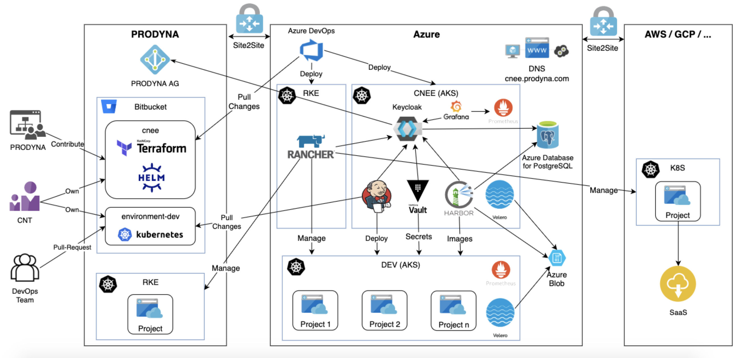
TARGET ENVIRONMENT
CNEE (Cloud-Native Engineering Environment)

Slide 19





TARGET ENVIRONMENT
Definition of infrastructure with Teraform
Infrastructure Services
Monitoring
Prometheus
Grafana
Authentication & Authorization
Keycloak
Build and Deployment Prozesses
Jenkins
Pipelines

Slide 20
SUMMARY

Slide 21
SUMMARY
Management of conference data
REST services with Spring Boot
Secure communication
Authentication and Authorisation
Monitoring
Scalability
NEO4J
Performance
Fexibility

Slide 22
SUMMARY(2)
Frontend
Web Frontend with Angular
Non-Functional Requirements
CNEE
Flexible Kubernetes Environment
Scalable
Infrastructure for build and deployment processes

Slide 23
Questions?

